Slide 1
Rich Code For Tiny Computers
A Simple Commodore 64 Game in C++17
http://tinyurl.com/RichCodeCppCon2016

Slide 2
Poll – I regularly program for:
Desktop / server / embedded CPUs like ARM and x86
Microcontrollers
40 year old 8 bit CPUs

Slide 3
The Plan
Implement a simple game for the Commodore 64
In C++17
Have fun while doing it
We won’t write every line live – that would be too boring

Slide 4
The Tools
Matt Godbolt’s Compiler Explorer @mattgodbolt
http://gcc.godbolt.org
clang git build for C++17 features
x86-to-6502 conversion tool (more on that in a minute)

Slide 5
The Why
I grew up using the Commodore 64
But never really had an understanding of its architecture
I recently decided to learn more and wanted to use my favorite programming language…
But no modern compilers officially supported 40 year old 6502 CPU…

Slide 6
The How
We’ll use a modern C++ compiler with full optimizations to generate very simple x86 code
Then translate this to 6502 code for the C64
Most people consider this to be insane, but it turns out it was easier than actually trying to support 6502 with llvm
Sometimes doing the crazy thing is more fun… when not being paid to do it

Slide 7
x86-to-6502
main:
movb $10, %al
.LBB0_1:
movb %al, 53280
movzbl 53280, %eax
incb %al
jmp .LBB0_1
main
lda #10
sta $03
lbb01
lda $03
sta 53280
sta $03
inc $03
jmp lbb01

Slide 8
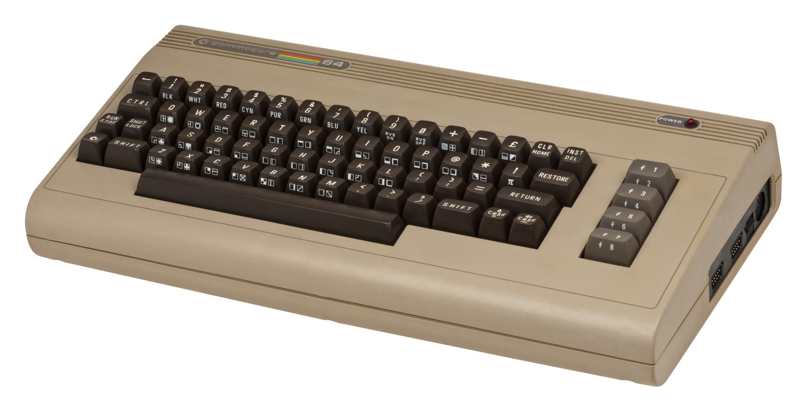
https://en.wikipedia.org/wiki/Commodore_64#/media/File:Commodore-64-Computer.png

Slide 9
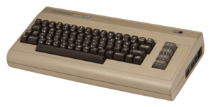
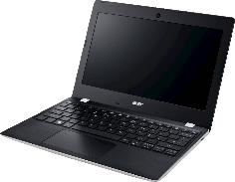
Then Vs Now
Commodore 64 (1982)
Acer Aspire One 11 (2016)
$595 ($1481 in today’s dollars)
1.023Mhz 6510 (NTSC) (6502 - 1975)
64kB RAM
8 bit CPU with 16 bit address space
$150 (~1/10 the price)
Dual Core Celeron 1.6-2.5Ghz (4880x)
2GB RAM (32768x)
64 bit CPU
Our demo today can easily fit in the L1 cache of this CPU

Slide 10
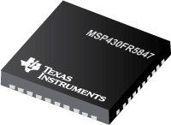
Then Vs Now
Commodore 64
MSP430-FR5849
$595 ($1481 in today’s dollars)
1.023Mhz 6510 (NTSC)
64kB RAM
8 bit CPU with 16 bit address space
$5.53 (Less in bulk)
16 Mhz
66kB RAM
16 bit CPU
Some level of official gcc and clang support today.

Slide 11
The Game

Slide 12
Simple pong clone
Ball
Bouncy Walls
7
Scores
3
Paddles

Slide 13
30 second computer architecture intro
Oversimplified, incomplete, and likely to get lots of comments on YouTube about what I left out.

Slide 20
Example: Video Chip
In C64: The VIC-II

Slide 21
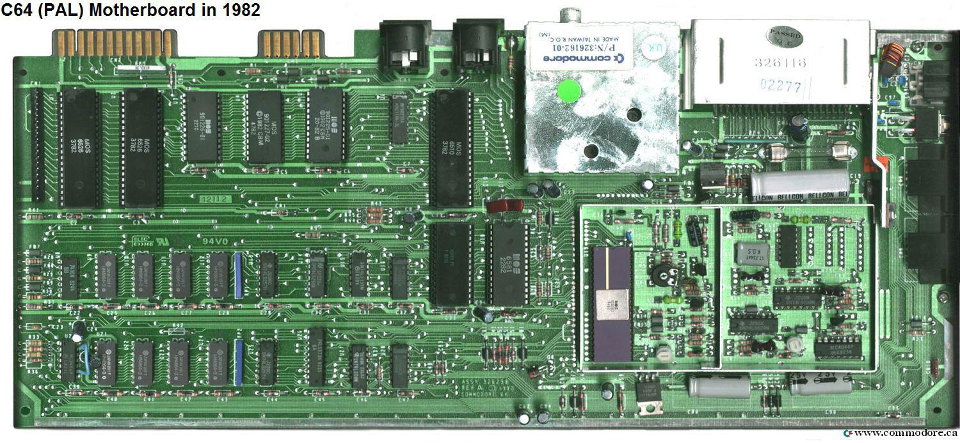
CPU
RAM
VICII

Slide 22
The (runtime) overhead game
Some Overhead?
No overhead?

Slide 23
Memory mapped hardware

Slide 24
Memory mapping
Devices are connected directly to the CPU’s address bus
Reading and writing to specific memory locations controls devices
Example: setting 0xD020 = 1 tells the video controller to set the border color to white.

Slide 26
Video Memory

Slide 27
Border: Address 53280 0xD020
Background: Address 53281 0xD021
Body: Default Address 1024 0x0400
0 | 1 | 2 | 3 | 4 | 5 | 6 | 7 | … | 33 | 34 | 35 | 36 | 37 | 38 | 39
40 | 41 | 42 | 43 | 44 | 45 | 46 | 47 | … | 73 | 74 | 75 | 76 | 77 | 78 | 79
80 | 81 | 82 | 83 | 84 | 85 | 86 | 87 | … | 113 | 114 | 115 | 116 | 117 | 118 | 119
.
.
.
880 | 881 | 882 | 883 | 884 | 885 | 886 | 887 | … | 913 | 914 | 915 | 916 | 917 | 918 | 919
920 | 921 | 922 | 923 | 924 | 925 | 926 | 927 | … | 953 | 954 | 955 | 956 | 957 | 958 | 959
960 | 961 | 962 | 963 | 964 | 965 | 966 | 967 | … | 993 | 994 | 995 | 996 | 997 | 998 | 999

Slide 29
Dealing with colors

Slide 30
The ViC-II Supports 16 Colors
0 | 1 | 2 | 3 | 4 | 5 | 6 | 7
8 | 9 | 10 | 11 | 12 | 13 | 14 | 15

Slide 31
The ViC-II Supports 16 Colors
“Red” RGB(136, 57, 50)
0 | 1 | 2 | 3 | 4 | 5 | 6 | 7
8 | 9 | 10 | 11 | 12 | 13 | 14 | 15
“Light Red” RGB(184, 105, 98)

Slide 32
Working with a fixed palette
Goal: easier working with the C64’s fixed palette
Idea: converting from RGB to the nearest available color
How: pretend that RGB values represent X,Y,Z coordinates in 3D space, look for the closest points
Note: this is not accurate to how the human eye sees colors, but it works for this purpose

Slide 34
Daily programming puzzle

Slide 35
Constexpr palette work
What we did here works because the compiler is able to optimize it
The programming puzzle for today is to make the nearest_color<> template fully constexpr enabled
If you succeed, there’s a following puzzle to sort the palette by luma, at compile-time with constexpr

Slide 36
Using C++14
This problem will actually be much easier once C++17 is fully available
Today, however, we have C++14
This exercise will help you appreciate how more constexpr support in the standard library can help you make more efficient code

Slide 37
joystick

Slide 38
joysticks
2 Joystick Ports
State of joystick is accessed via the memory map

Slide 39
joysticks
Port B – Joystick #1 – 56321 (0xDC01)
7 | 6 | 5 | 4 | 3 | 2 | 1 | 0
 |  |  | ! Fire | ! Right | ! Left | ! Down | ! Up
Port A – Joystick #2 – 56320 (0xDC00)
7 | 6 | 5 | 4 | 3 | 2 | 1 | 0
 |  |  | ! Fire | ! Right | ! Left | ! Down | ! Up

Slide 41
RAII

Slide 42
RAII
Resource Acquisition Is Initialization
Essentially – using constructors and destructors to manage state and resources
Many consider this to be the greatest strength of C++
I like to put this another way: well-defined object lifetime is C++’s greatest strength

Slide 44
Commodore 64 Sprites

Slide 45
Vic-II sprites
8 hardware sprites
Hardware sprite collision detection
Sprites are 24x21 pixels
Sprites can be single color or multicolor
Sprites can have their height or width doubled

Slide 46
Monochrome sprite
Each bit represents 1 pixel

Slide 49
0 | 0 | 0 | 1 | 1 | 1 | 1 | 0
0 | 1 | 1 | 1 | 1 | 1 | 1 | 0
0 | 1 | 1 | 1 | 1 | 0 | 0 | 0

Slide 50
0 | 0 | 0 | 1 | 1 | 1 | 1 | 0
0 | 1 | 1 | 1 | 1 | 1 | 1 | 0
0 | 1 | 1 | 1 | 1 | 0 | 0 | 0
30
126
120

Slide 51
0 | 0 | 0 | 0 | 0 | 0 | 0 | 0 | 0 | 1 | 1 | 1 | 1 | 1 | 1 | 0 | 0 | 0 | 0 | 0 | 0 | 0 | 0 | 0
0 | 0 | 0 | 0 | 0 | 0 | 0 | 1 | 1 | 1 | 1 | 1 | 1 | 1 | 1 | 1 | 1 | 0 | 0 | 0 | 0 | 0 | 0 | 0
0 | 0 | 0 | 0 | 0 | 1 | 1 | 1 | 1 | 1 | 1 | 1 | 1 | 1 | 1 | 1 | 1 | 1 | 1 | 0 | 0 | 0 | 0 | 0
0 | 0 | 0 | 0 | 1 | 1 | 1 | 1 | 1 | 1 | 1 | 1 | 1 | 1 | 1 | 1 | 1 | 1 | 1 | 1 | 0 | 0 | 0 | 0
0 | 0 | 0 | 0 | 1 | 1 | 1 | 1 | 1 | 1 | 1 | 1 | 1 | 1 | 1 | 1 | 1 | 1 | 1 | 1 | 0 | 0 | 0 | 0
0 | 0 | 0 | 1 | 1 | 1 | 1 | 0 | 0 | 1 | 1 | 1 | 1 | 1 | 1 | 0 | 0 | 1 | 1 | 1 | 1 | 0 | 0 | 0
0 | 0 | 0 | 1 | 1 | 1 | 1 | 0 | 0 | 1 | 1 | 1 | 1 | 1 | 1 | 0 | 0 | 1 | 1 | 1 | 1 | 0 | 0 | 0
0 | 0 | 1 | 1 | 1 | 1 | 1 | 0 | 0 | 1 | 1 | 1 | 1 | 1 | 1 | 0 | 0 | 1 | 1 | 1 | 1 | 1 | 0 | 0
0 | 0 | 1 | 1 | 1 | 1 | 1 | 1 | 1 | 1 | 1 | 1 | 1 | 1 | 1 | 1 | 1 | 1 | 1 | 1 | 1 | 1 | 0 | 0
0 | 0 | 1 | 1 | 1 | 1 | 1 | 1 | 1 | 1 | 1 | 1 | 1 | 1 | 1 | 1 | 1 | 1 | 1 | 1 | 1 | 1 | 0 | 0
0 | 0 | 1 | 1 | 1 | 1 | 1 | 1 | 1 | 1 | 1 | 1 | 1 | 1 | 1 | 1 | 1 | 1 | 1 | 1 | 1 | 1 | 0 | 0
0 | 0 | 1 | 1 | 1 | 1 | 1 | 1 | 1 | 1 | 1 | 1 | 1 | 1 | 1 | 1 | 1 | 1 | 1 | 1 | 1 | 1 | 0 | 0
0 | 0 | 1 | 1 | 1 | 1 | 1 | 1 | 1 | 1 | 1 | 1 | 1 | 1 | 1 | 1 | 1 | 1 | 1 | 1 | 1 | 1 | 0 | 0
0 | 0 | 0 | 1 | 0 | 0 | 1 | 1 | 1 | 1 | 1 | 1 | 1 | 1 | 1 | 1 | 1 | 1 | 0 | 0 | 1 | 0 | 0 | 0
0 | 0 | 0 | 1 | 1 | 0 | 1 | 1 | 1 | 1 | 1 | 1 | 1 | 1 | 1 | 1 | 1 | 1 | 0 | 1 | 1 | 0 | 0 | 0
0 | 0 | 0 | 0 | 1 | 1 | 0 | 1 | 1 | 1 | 1 | 1 | 1 | 1 | 1 | 1 | 1 | 0 | 1 | 1 | 0 | 0 | 0 | 0
0 | 0 | 0 | 0 | 1 | 1 | 1 | 0 | 0 | 1 | 1 | 1 | 1 | 1 | 1 | 0 | 0 | 1 | 1 | 1 | 0 | 0 | 0 | 0
0 | 0 | 0 | 0 | 0 | 1 | 1 | 1 | 1 | 0 | 0 | 0 | 0 | 0 | 0 | 1 | 1 | 1 | 1 | 0 | 0 | 0 | 0 | 0
0 | 0 | 0 | 0 | 0 | 0 | 0 | 1 | 1 | 1 | 1 | 1 | 1 | 1 | 1 | 1 | 1 | 0 | 0 | 0 | 0 | 0 | 0 | 0
0 | 0 | 0 | 0 | 0 | 0 | 0 | 0 | 0 | 1 | 1 | 1 | 1 | 1 | 1 | 0 | 0 | 0 | 0 | 0 | 0 | 0 | 0 | 0
0 | 0 | 0 | 0 | 0 | 0 | 0 | 0 | 0 | 0 | 0 | 0 | 0 | 0 | 0 | 0 | 0 | 0 | 0 | 0 | 0 | 0 | 0 | 0
0 | 126 | 0
1 | 255 | 128
7 | 255 | 224
15 | 255 | 240
15 | 255 | 240
30 | 126 | 120
30 | 126 | 120
62 | 126 | 124
63 | 255 | 252
63 | 255 | 252
63 | 255 | 252
63 | 255 | 252
63 | 255 | 252
19 | 255 | 200
27 | 255 | 216
13 | 255 | 176
14 | 126 | 112
7 | 129 | 224
1 | 255 | 128
0 | 126 | 0
0 | 0 | 0

Slide 53
How much work was that, exactly?
How many function parameters and how many function calls?
Hint: 24x21 pixels
504 + 1 parameters (first function)
8 params less per recursion, 63 + 1 recursions

Slide 54
Multi color sprite
Every 2 bits represents 2 pixels of the same color.

Slide 57
0 | 0 | 1 | 1
3 | 1 | 1 | 3
1 | 1 | 0 | 0

Slide 58
0 | 0 | 1 | 1
3 | 1 | 1 | 3
1 | 1 | 0 | 0
00 | 00 | 01 | 01
11 | 01 | 01 | 11
01 | 01 | 00 | 00

Slide 59
0 | 0 | 1 | 1
3 | 1 | 1 | 3
1 | 1 | 0 | 0
00 | 00 | 01 | 01
11 | 01 | 01 | 11
01 | 01 | 00 | 00
5
215
80

Slide 60
0 | 0 | 0 | 0 | 1 | 1 | 1 | 1 | 0 | 0 | 0 | 0
0 | 0 | 0 | 1 | 1 | 1 | 1 | 1 | 1 | 0 | 0 | 0
0 | 0 | 0 | 1 | 1 | 1 | 1 | 1 | 1 | 0 | 0 | 0
0 | 0 | 1 | 1 | 1 | 1 | 1 | 1 | 1 | 1 | 0 | 0
0 | 0 | 1 | 1 | 1 | 1 | 1 | 1 | 1 | 1 | 0 | 0
0 | 0 | 1 | 1 | 3 | 1 | 1 | 3 | 1 | 1 | 0 | 0
0 | 1 | 1 | 1 | 3 | 1 | 1 | 3 | 1 | 1 | 1 | 0
0 | 1 | 1 | 1 | 1 | 1 | 1 | 1 | 1 | 1 | 1 | 0
0 | 1 | 1 | 1 | 1 | 1 | 1 | 1 | 1 | 1 | 1 | 0
0 | 1 | 1 | 1 | 1 | 1 | 1 | 1 | 1 | 1 | 1 | 0
0 | 1 | 1 | 1 | 1 | 1 | 1 | 1 | 1 | 1 | 1 | 0
0 | 1 | 1 | 1 | 1 | 1 | 1 | 1 | 1 | 1 | 1 | 0
0 | 1 | 1 | 1 | 1 | 1 | 1 | 1 | 1 | 1 | 1 | 0
0 | 1 | 1 | 1 | 1 | 1 | 1 | 1 | 1 | 1 | 1 | 0
0 | 0 | 1 | 1 | 1 | 1 | 1 | 1 | 1 | 1 | 0 | 0
0 | 0 | 1 | 2 | 1 | 1 | 1 | 1 | 2 | 1 | 0 | 0
0 | 0 | 1 | 1 | 2 | 1 | 1 | 2 | 1 | 1 | 0 | 0
0 | 0 | 0 | 1 | 2 | 2 | 2 | 2 | 1 | 0 | 0 | 0
0 | 0 | 0 | 1 | 1 | 1 | 1 | 1 | 1 | 0 | 0 | 0
0 | 0 | 0 | 0 | 1 | 1 | 1 | 1 | 0 | 0 | 0 | 0
0 | 0 | 0 | 0 | 0 | 0 | 0 | 0 | 0 | 0 | 0 | 0

Slide 61
00 | 00 | 00 | 00 | 01 | 01 | 01 | 01 | 00 | 00 | 00 | 00
00 | 00 | 00 | 01 | 01 | 01 | 01 | 01 | 01 | 00 | 00 | 00
00 | 00 | 00 | 01 | 01 | 01 | 01 | 01 | 01 | 00 | 00 | 00
00 | 00 | 01 | 01 | 01 | 01 | 01 | 01 | 01 | 01 | 00 | 00
00 | 00 | 01 | 01 | 01 | 01 | 01 | 01 | 01 | 01 | 00 | 00
00 | 00 | 01 | 01 | 11 | 01 | 01 | 11 | 01 | 01 | 00 | 00
00 | 01 | 01 | 01 | 11 | 01 | 01 | 11 | 01 | 01 | 01 | 00
00 | 01 | 01 | 01 | 01 | 01 | 01 | 01 | 01 | 01 | 01 | 00
00 | 01 | 01 | 01 | 01 | 01 | 01 | 01 | 01 | 01 | 01 | 00
00 | 01 | 01 | 01 | 01 | 01 | 01 | 01 | 01 | 01 | 01 | 00
00 | 01 | 01 | 01 | 01 | 01 | 01 | 01 | 01 | 01 | 01 | 00
00 | 01 | 01 | 01 | 01 | 01 | 01 | 01 | 01 | 01 | 01 | 00
00 | 01 | 01 | 01 | 01 | 01 | 01 | 01 | 01 | 01 | 01 | 00
00 | 01 | 01 | 01 | 01 | 01 | 01 | 01 | 01 | 01 | 01 | 00
00 | 00 | 01 | 01 | 01 | 01 | 01 | 01 | 01 | 01 | 00 | 00
00 | 00 | 01 | 10 | 01 | 01 | 01 | 01 | 10 | 01 | 00 | 00
00 | 00 | 01 | 01 | 10 | 01 | 01 | 10 | 01 | 01 | 00 | 00
00 | 00 | 00 | 01 | 10 | 10 | 10 | 10 | 01 | 00 | 00 | 00
00 | 00 | 00 | 01 | 01 | 01 | 01 | 01 | 01 | 00 | 00 | 00
00 | 00 | 00 | 00 | 01 | 01 | 01 | 01 | 00 | 00 | 00 | 00
00 | 00 | 00 | 00 | 00 | 00 | 00 | 00 | 00 | 00 | 00 | 00
0 | 85 | 0
1 | 85 | 64
1 | 85 | 64
5 | 85 | 80
5 | 85 | 80
5 | 215 | 80
21 | 215 | 84
21 | 85 | 84
21 | 85 | 84
21 | 85 | 84
21 | 85 | 84
21 | 85 | 84
21 | 85 | 84
21 | 85 | 84
5 | 85 | 80
6 | 85 | 144
5 | 150 | 80
1 | 170 | 64
1 | 85 | 64
0 | 85 | 0
0 | 0 | 0

Slide 63
Putting It All together

Slide 64
200
320

Slide 65
200
255

Slide 67
Wrap-up

Slide 68
Why does this work?
Straightforward logic
Very little branching
Letting the compiler work for us
Function inlining is very important
Compile-time calculations save runtime work
How much RAM did we use at runtime?

Slide 69
Zero overhead abstractions
Objects
Methods
(Delegating) Constructors / Destructors
Lambdas with/without captures
Structured bindings (aka destructuring)
Function calls that have been inlined
If-init
Templates (variadic, recursive)
Standard algorithms

Slide 70
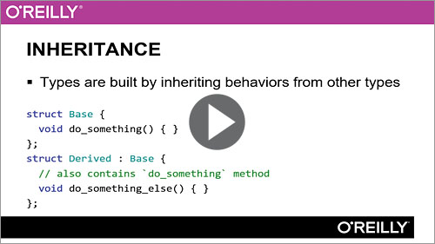
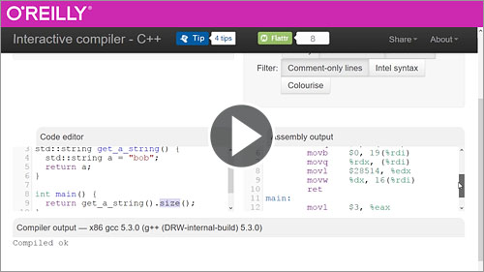
Questions
CppCast (http://cppcast.com)
C++ Weekly YouTube Channel
http://articles.emptycrate.com/idocpp
Inheritance and Polymorphism with C++
Learning C++ Best Practices

